Slide 1
SDB Predicting Energy Usage at 88acres
Mike Wise
Version 0.4
21 July 2015

Slide 2
SDB Business Goals
Energy Usage Prediction
Planning and Hedging Energy Purchasing Strategies
Predicting and Mitigating Peak Energy usage to reduce Demand Charges
Predictive Maintenance
Recalibrating fault importance
Measuring impact of equipment performance on Energy and Indoor Climate
Predicting equipment outages
Locating underperforming building regions

Slide 3
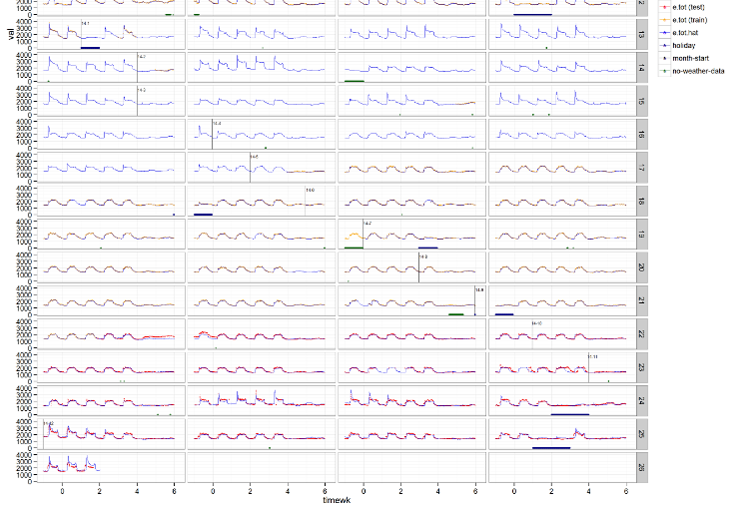
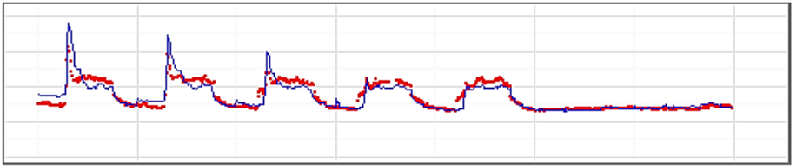
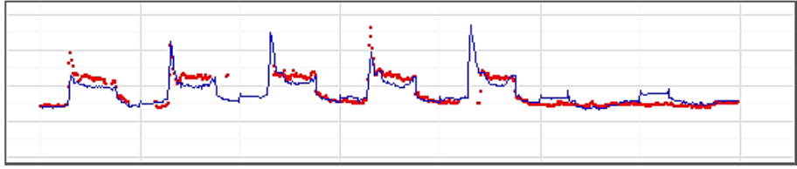
Typical Building Usage Profile

Slide 4
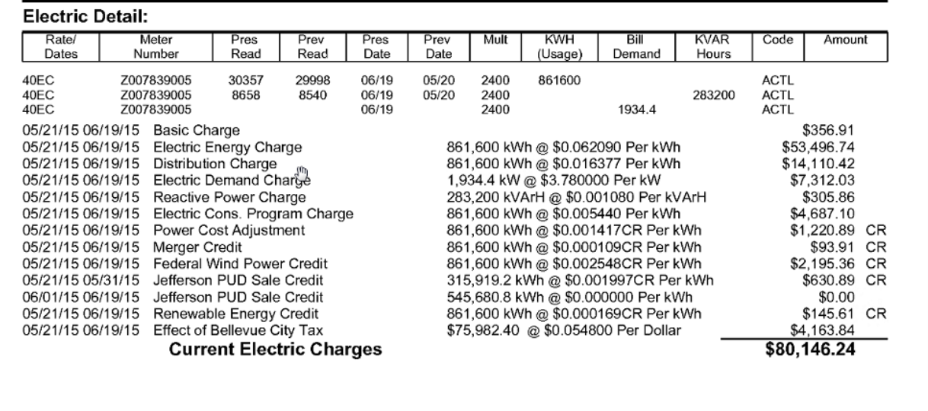
Typical Electric Bill with Usage/Demand Charges
Usage
Demand

Slide 5
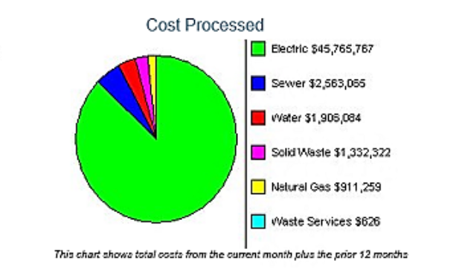
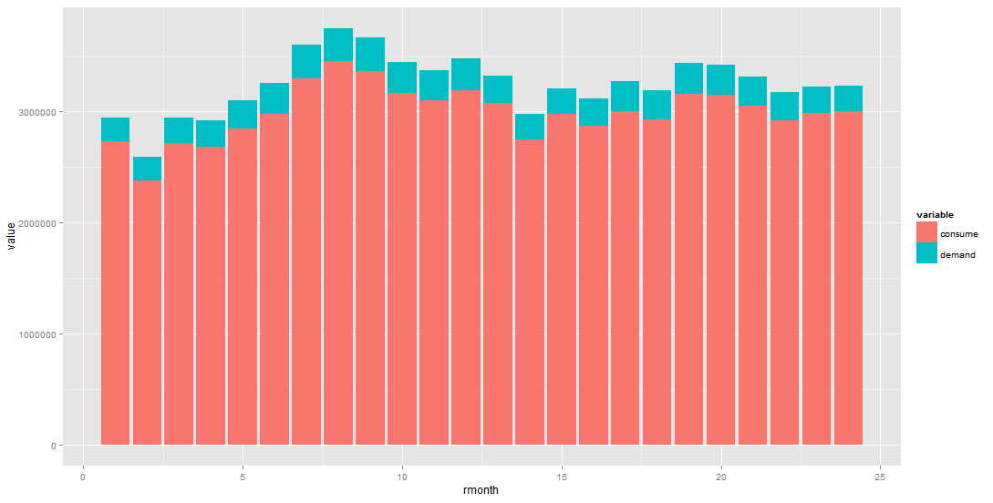
Yearly Financial Impact

Slide 6
Project Resources
1 TB of data – HVAC, Energy Usage, and some temperature data
Azure Account
SQL VM
Hadoop cluster
AML Workspace
1 full-time MCS DS Resource (me)
1 part-time (1.5 d/w) AML PG DS Resource

Slide 7
Compute Landscape

Slide 8
SDB – The Data Science
CRISP-DM – best developed DS methodology
Little competition
6 Phases
Business Understanding
Data Understanding
Data Preparation
Data Modelling
Evaluation
Deployment

Slide 9
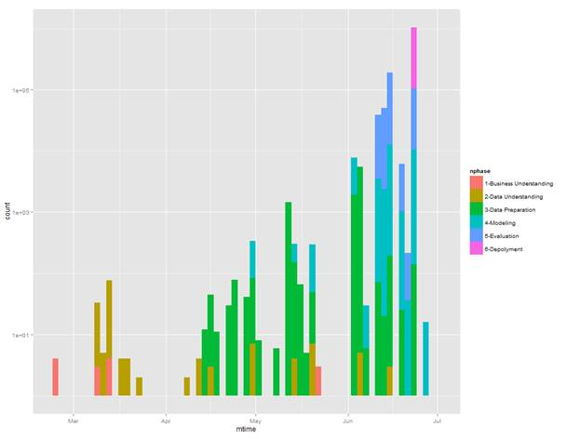
Time Line
4-5 months on project so far
Main project directory has 6000+ files in 62 folders

Slide 10
SDB Business Understanding - Overview
Actual Business Benefits articulated
Revisited at least twice during project
Initial focus was Pred.Maint. oriented, shifted to an Energy Focus
Energy Consumption underlies and prioritizes most other costs
Energy requires less data to understand (3-4 data streams per building)
Desire for quick-wins shifted focus again, to creation of a “demo”

Slide 11
SBD Business Cases
Business Understanding
Energy Business Scenarios
Energy Usage and Peak prediction in support of hedging
Predicting Energy Peaks so that they may be reduced proactively
Predictive Maintenance Business Scenarios
Measuring true costs (monetary and energy cost) of Faults-rule events
Predicting time to next mechanical failure
Classifying Fault-rule events into False Positives, True Positives, False Negatives, True Negatives
Measuring efficiency (power, climate control) of VAVs, etc. in buildings

Slide 12
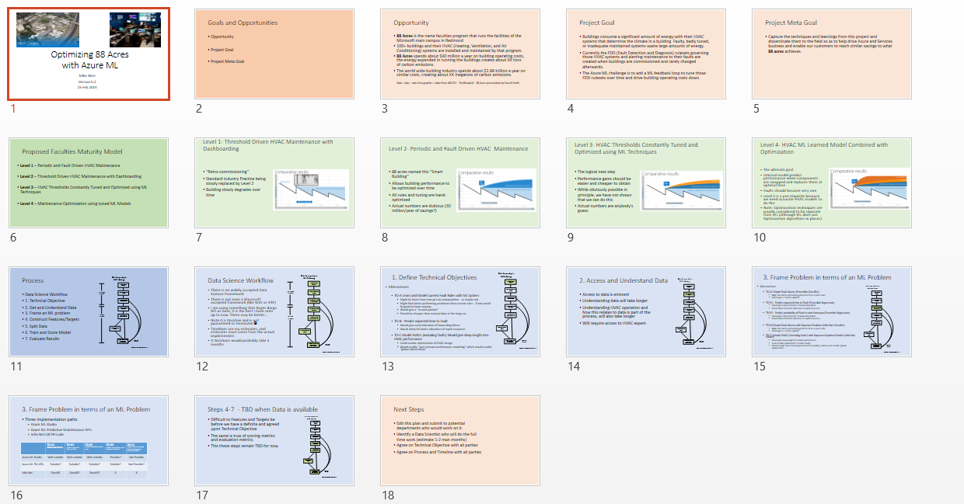
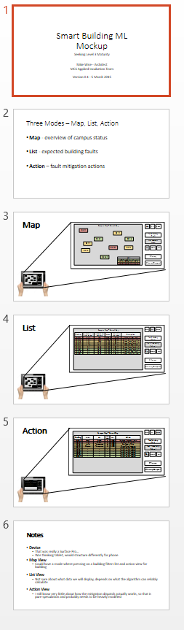
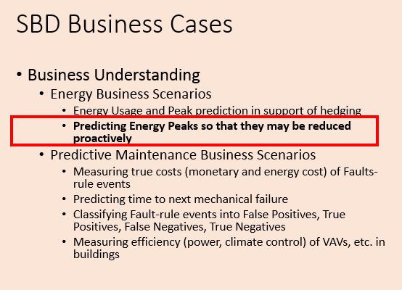
SBD Business Understanding
23 Feb 2015
5 March 2015
3 April 2015

Slide 13
SDB Data Understanding - Overview
Acquisition of data took time
Used R, Python, and sometimes Excel (not on Azure)
Delivered 1.5 TB of data in 9 SQL DBs
Approximately 500k (over 5000 per building or 14 per person!) data streams in 92 Puget Sound buildings
But only needed about 10-20 per building for first part of energy analysis phase
Data range was from 1 Jan 2013 to 31 Dec 2014

Slide 14
SDB - Data Understanding - Data Flow

Slide 15
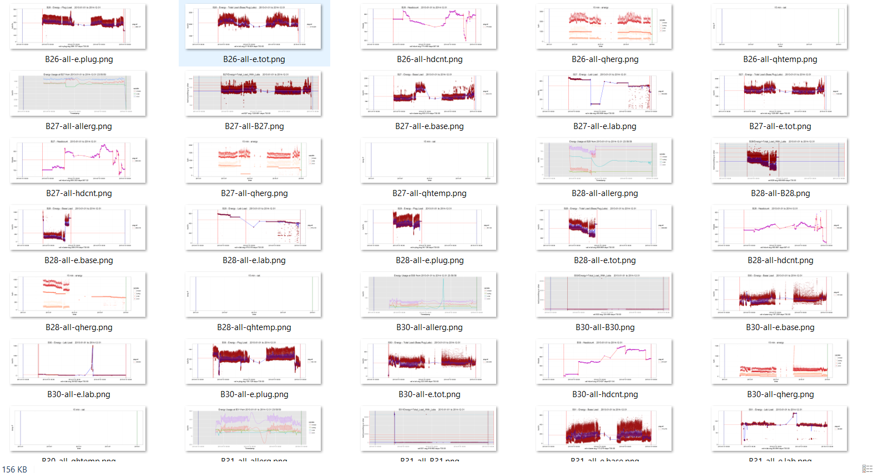
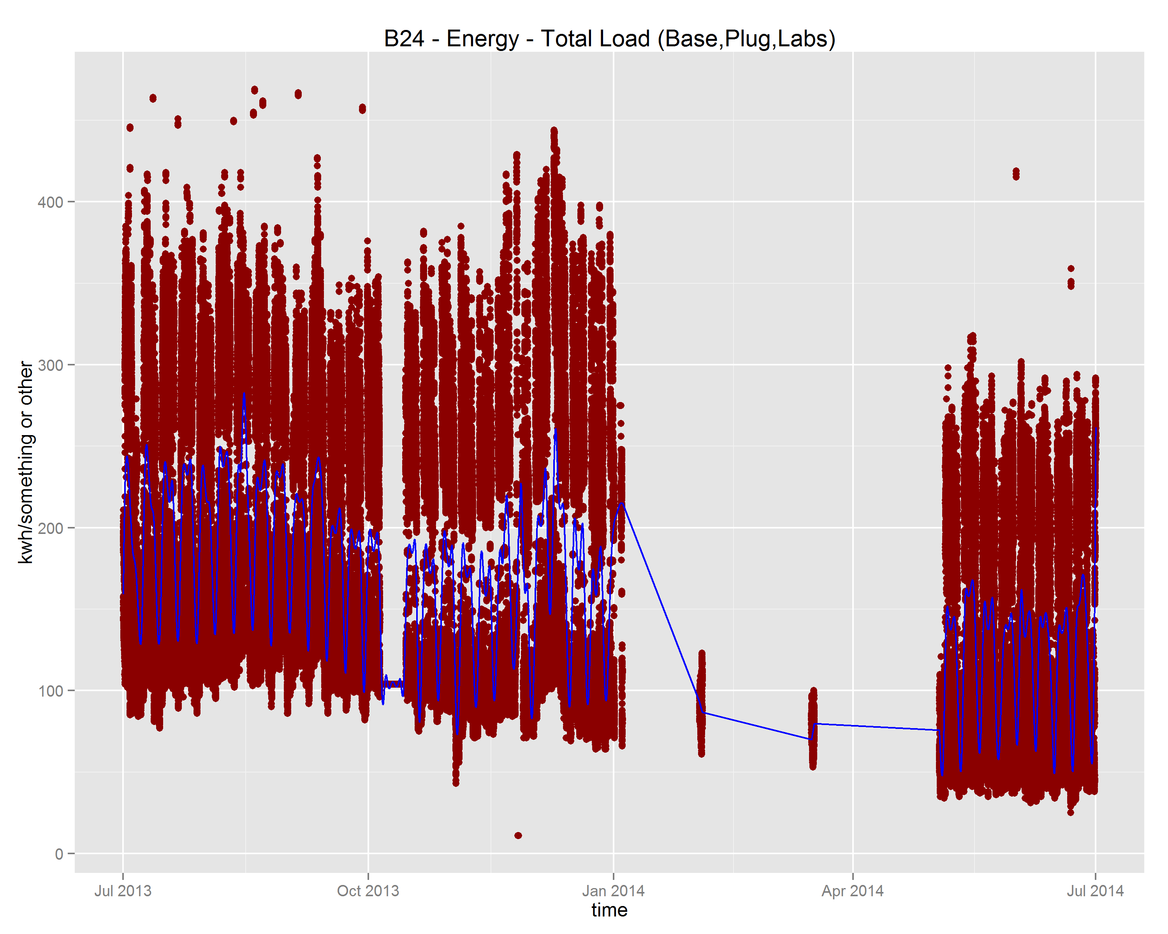
SDB Data Understanding – Building Data
Sampled at 1-10 minutes per stream depending on data type
All streams were missing data, up to 3 month gaps existed, most streams have between 20 and 80 percent coverage

Slide 16
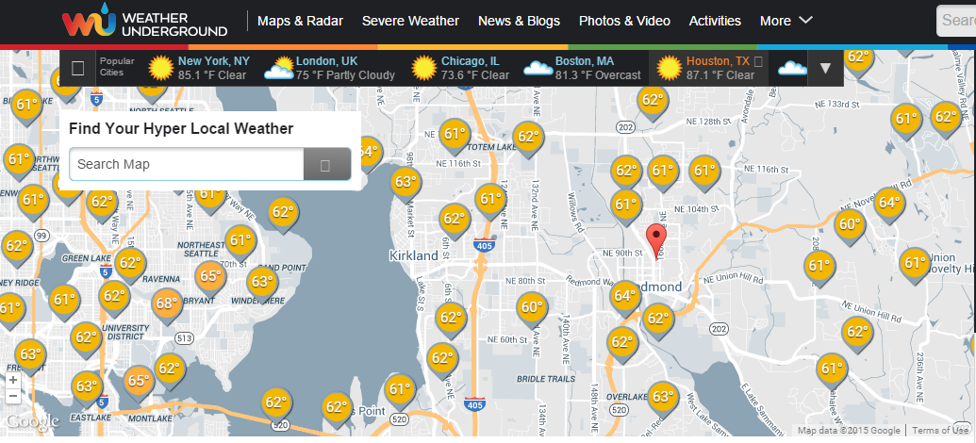
SDB Data Understanding – Weather Data
Weather Data from Weather Underground
10 values – including temperature, dewpoint, windspeed, humidity and some other – available as CSV
Not all stations have all data, or at all times
Took 4 weather stations in the Bellevue/Redmond/Kirkland area with continuous data back to 2009
Weather Data Gaps moved in the 1-2 percent range

Slide 17
SBD – Data Understanding Challenges
Large amount of data – 9 SQL DB between 320 and 160 GB
Unified over SQL view but was slow (could not build index over data)
Merging to one DB ran afoul of slow SQL Server, decided to switch to Hive
Exported to Hive – SIS output UCS-16
Noticed too late, made Hive twice as slow
Had to redo as UCS-8: 1.7 TB => 0.88 TB

Slide 18
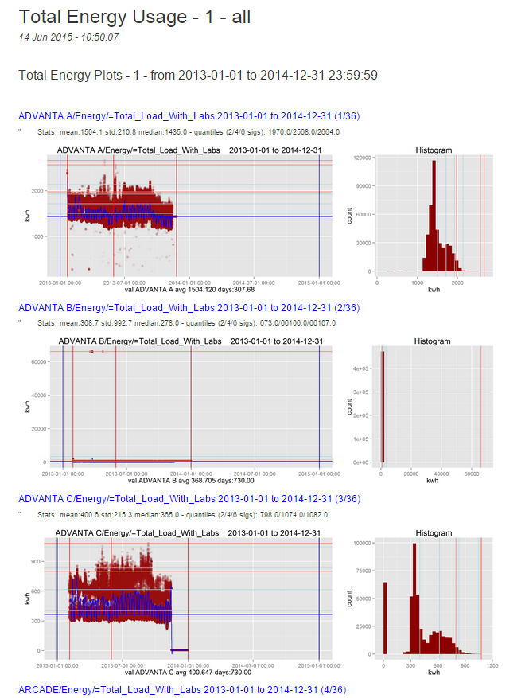
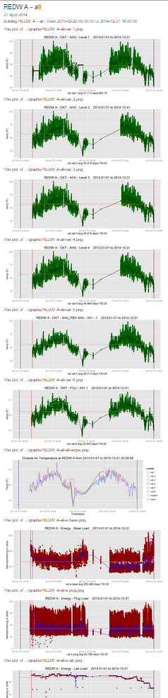
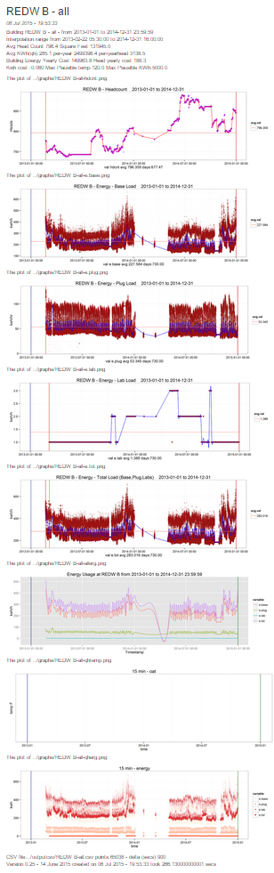
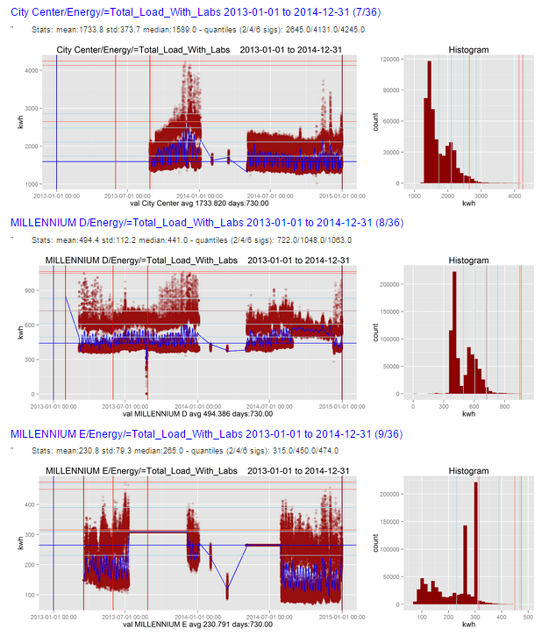
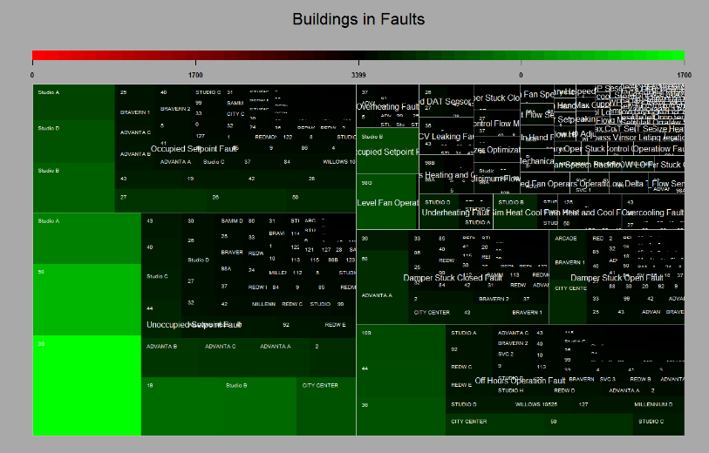
SDB - Data Understanding - Reports

Slide 19
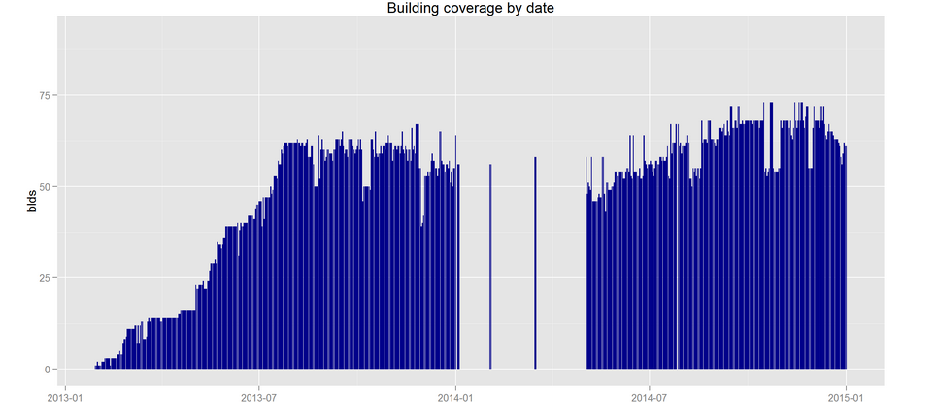
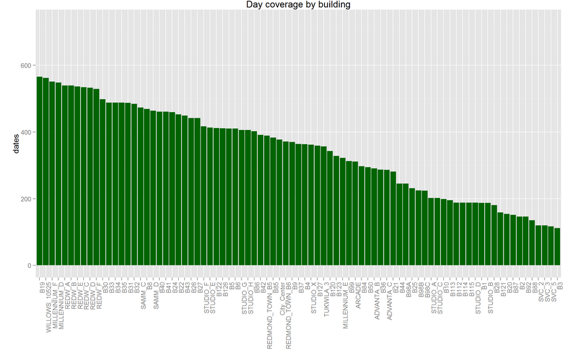
SDB - Data Understanding - Results

Slide 20
SDB - Data Understanding - Key Assets
Fault Explorer
Directories
2 – Fault Explorer
Data
tagcountStdAllavgMinMaxHead.csv
fdfaults.zip
tagvals.xlsx
Scripts
Shiny App – 2- Fault Explorer/ui.r & server.r
Tagcount sql creation script???
Hive Data Retrieval
Directories
3-hive/dataretrieval/
Scripts
createpartitionNN.ps1, gettagstream.ps1, getetot1.ps1, etc
Building Temp/Energy Reports
Directories
3-hive/[graphs,outputcsv,outputrmd,reports,tagcounts]
Data
outputrmd – 331 MB of 204 rmd and html reports
graphs – 144 MB of 987 plots (png)

Slide 21
SDB – Data Preparation - Overview
Weather data gathered and consolidated
Weather data in 3-5 minute intervals
Averaged and gathered into 15 minute chunks
Eliminated Nas Gaps covered by
averaging weather stations
Interpolating few remaining gaps
Building data gathered and consolidated
Energy data in variable
Averaged and gathered into 15 minute chunks
Created heating degrees and cooling degree variables
Added time data
Marker for holidays
Conversion of time into decimal time for easier mathematical manipulation
End result is data for AML

Slide 22
SDB – Data Preparation – Data flow

Slide 23
SDB – Data Preparation – Challenges
Data Understanding increased enormously, many surprises
Spline fitting turned out not to work so well, abandoned
Hard to find weather stations with complete coverage
Looking for at least 6 years of coverage, 10 would be better

Slide 24
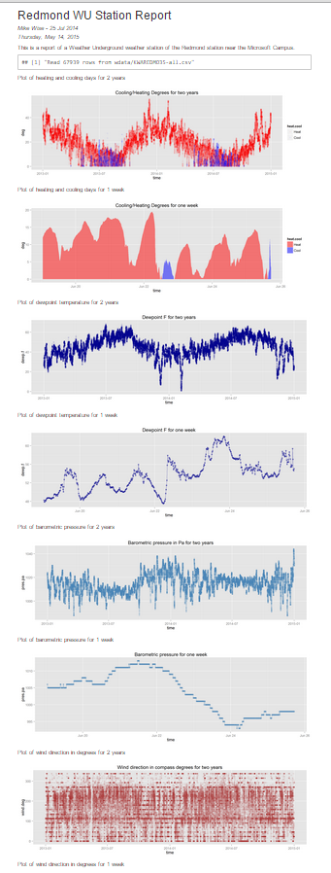
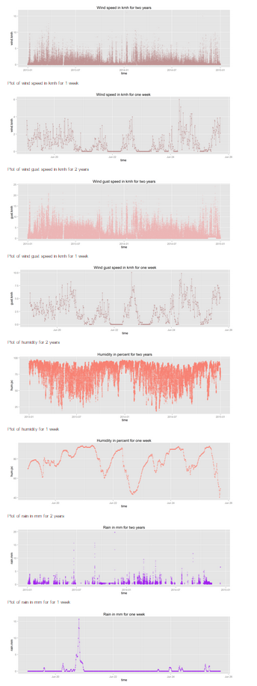
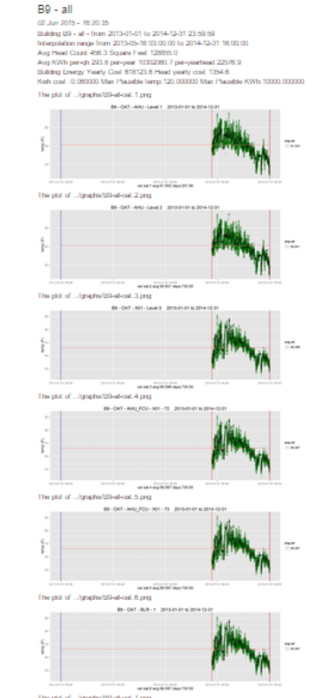
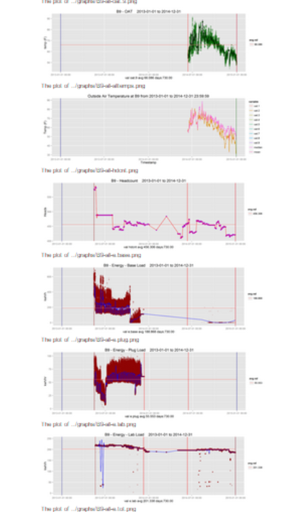
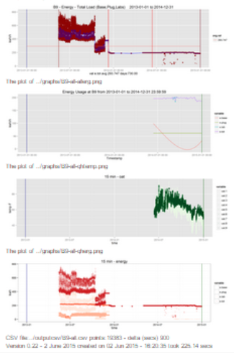
SDB – Data Preparation – Reports

Slide 25
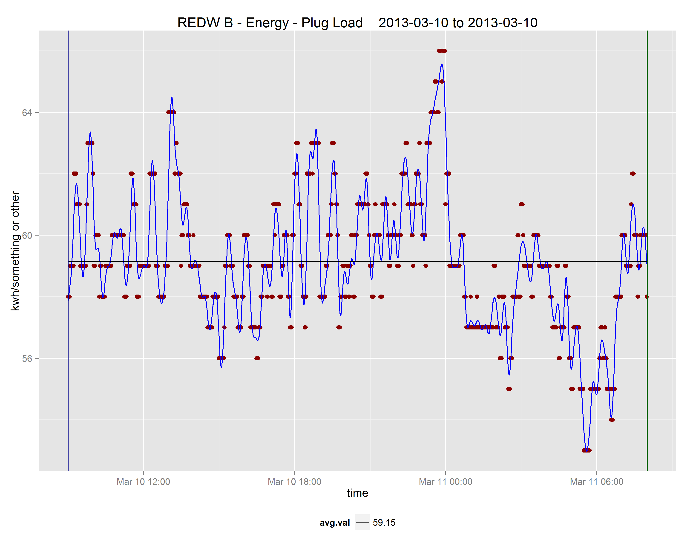
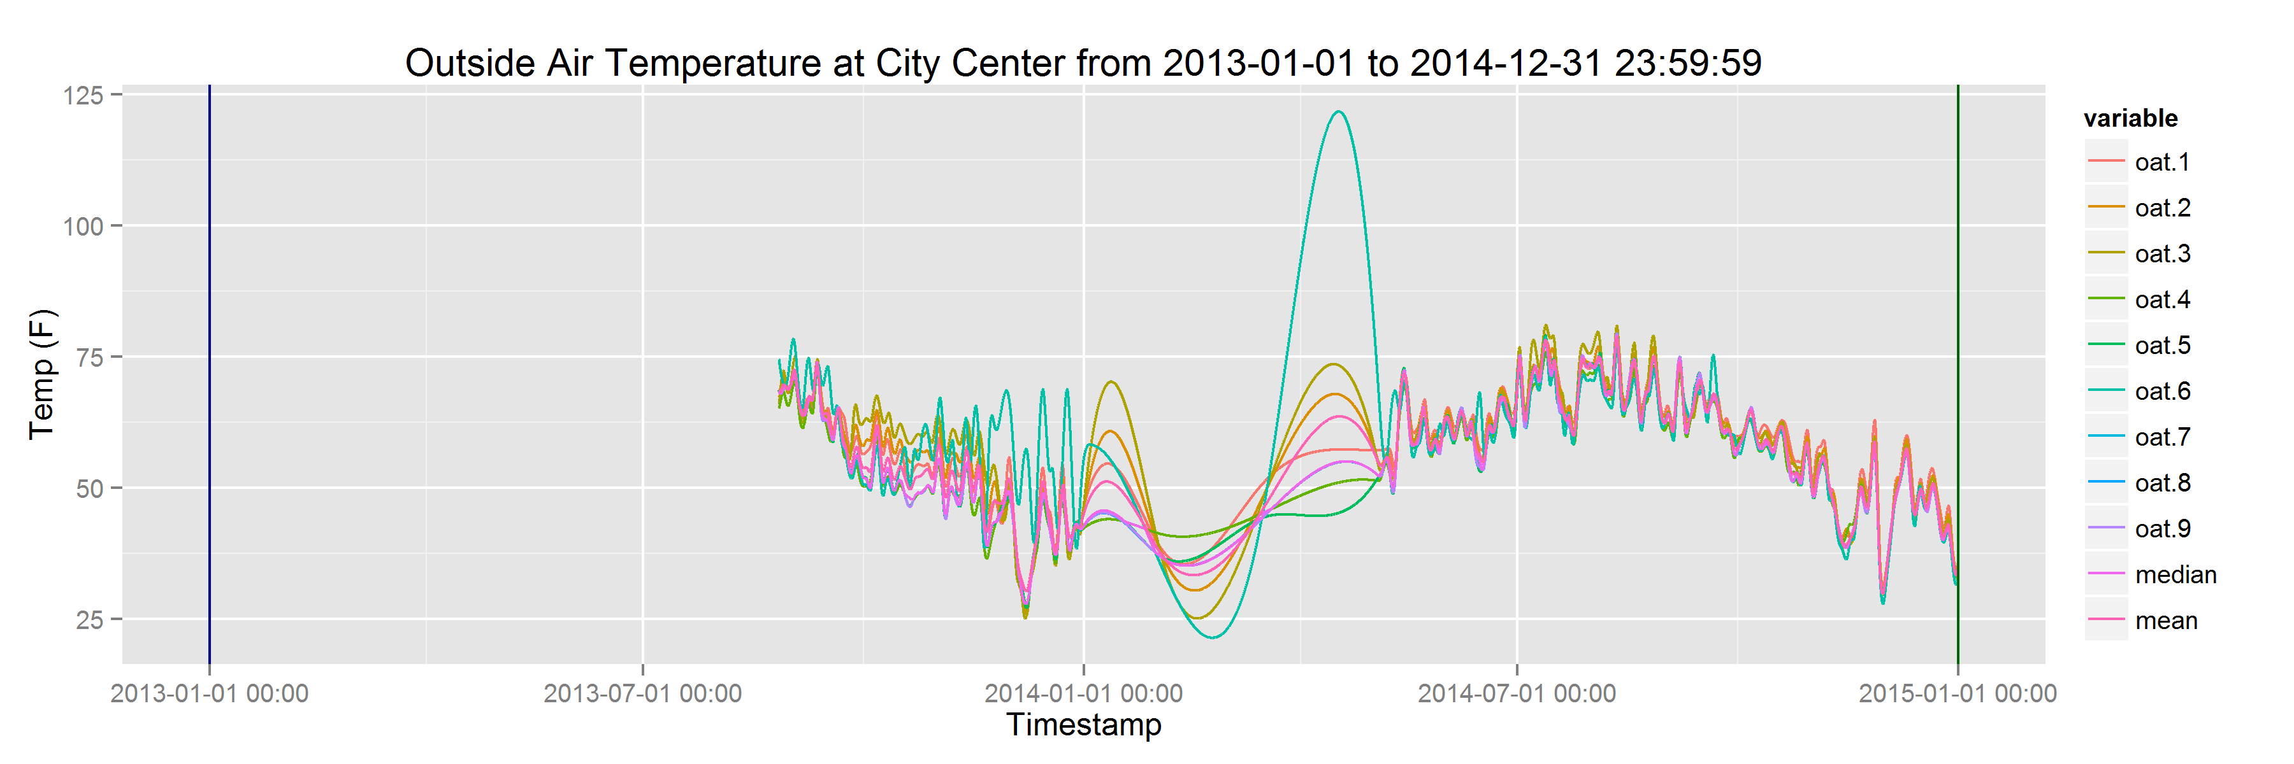
SDB – Data Preparation – Results

Slide 26
SDB - Data Preparation - Key Assets
Building Temp/Energy Reports
Directories
3-hive/[graphs,outputcsv,outputrmd,reports,tagcounts]
Data
outputcsv – 1.5 GB of 1575 prepared CSV files with processed data streams
/88blddata - 10.7 GB in 5256 csv files, 1 file per tag stream
Weather Processing

Slide 27
SDB Modeling - Overview
Considered different architectures
Went with Standard R and AML in the end
Many choices available today
Classic regression and optimization
Ensemble methods (Boosted Trees, Random Forests, etc.)
Other ML methods (NN, DNN, SVM, etc.)
Time Series forecasting (ARIMA)
Went with Ensemble methods as the are powerful, tolerant to missing data, and new and exciting ☺

Slide 28
SDB – Modeling - Architecture

Slide 29
SDB – Modeling - Challenges
92 buildings made modeling all buildings in AML practically impossible, only modeled about 20
No markup facilities in AML made reporting difficult
Wide variation in results over different buildings
Difficult to encompass results from 92 buildings

Slide 30
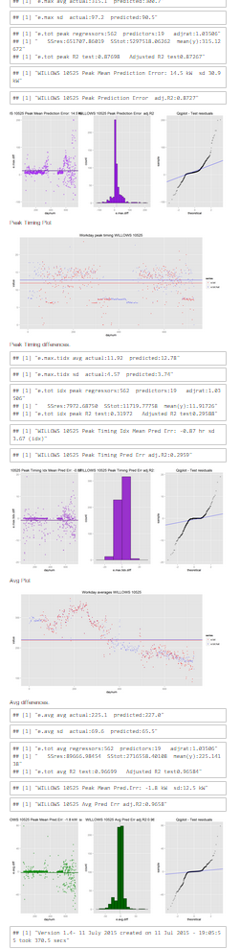
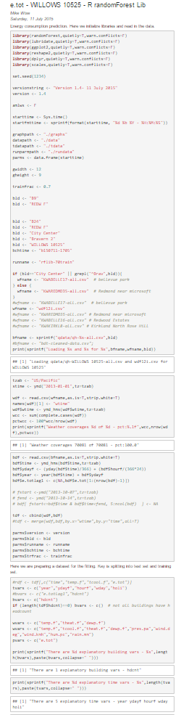
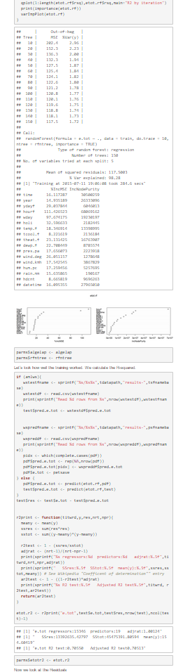
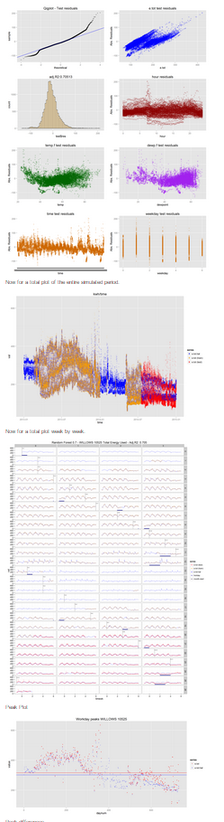
SDB – Modeling - Reports

Slide 31
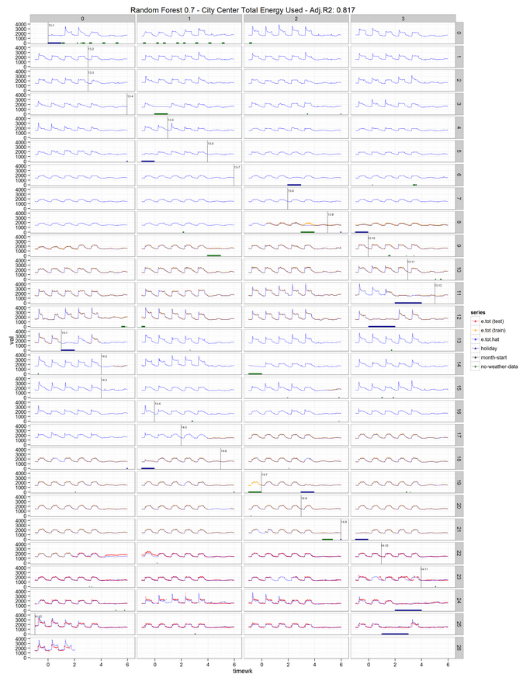
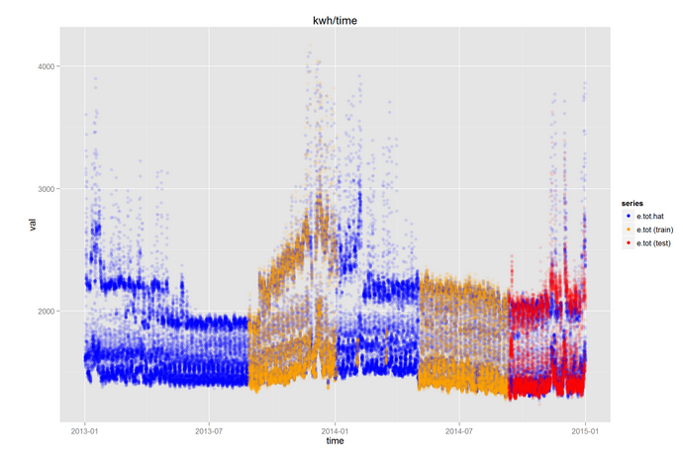
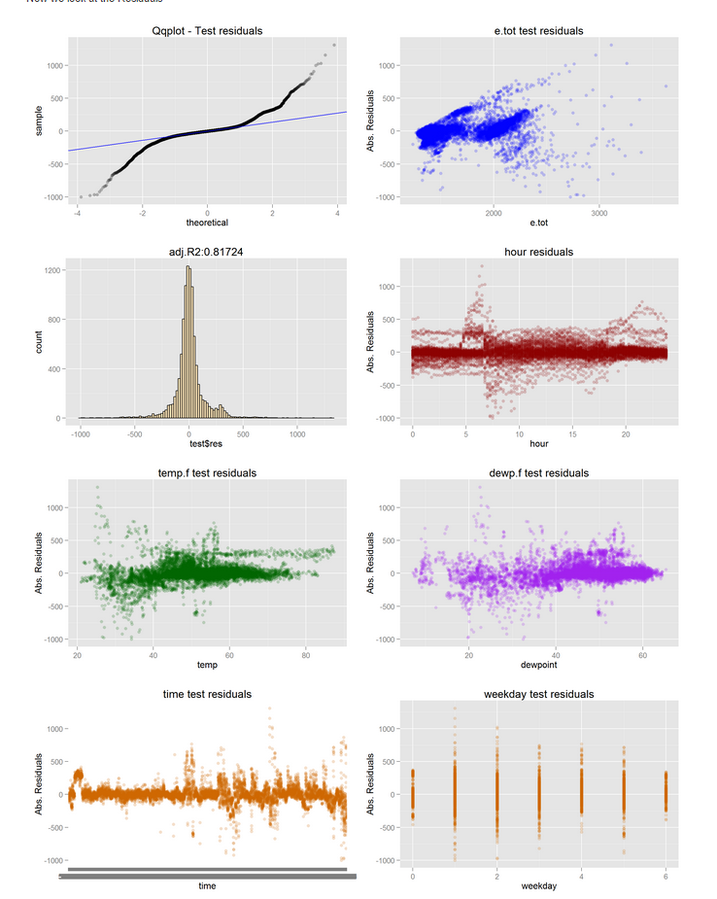
SDB – Modeling – Results (City Center)

Slide 32
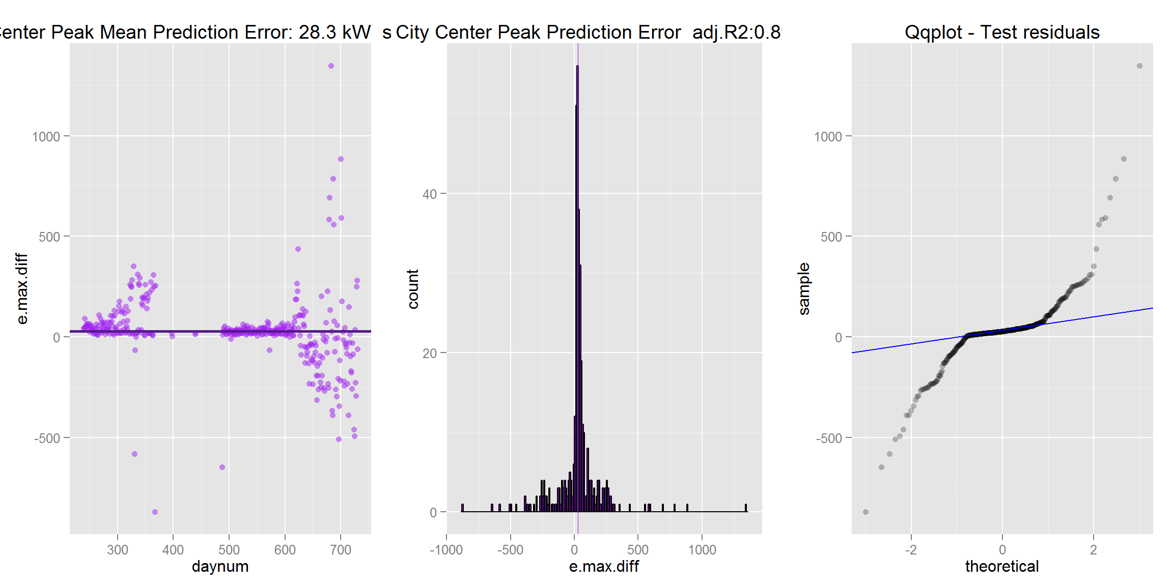
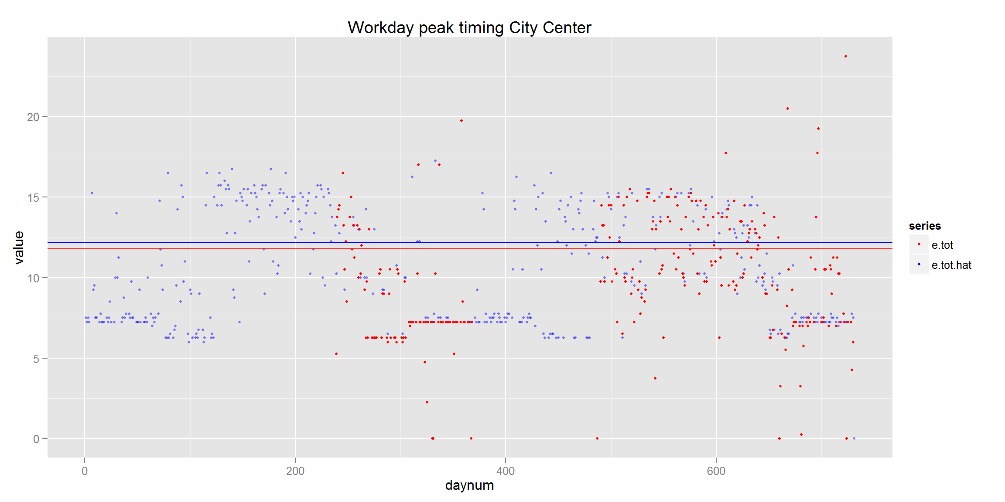
SDB – Modeling – Results (City Center)

Slide 33
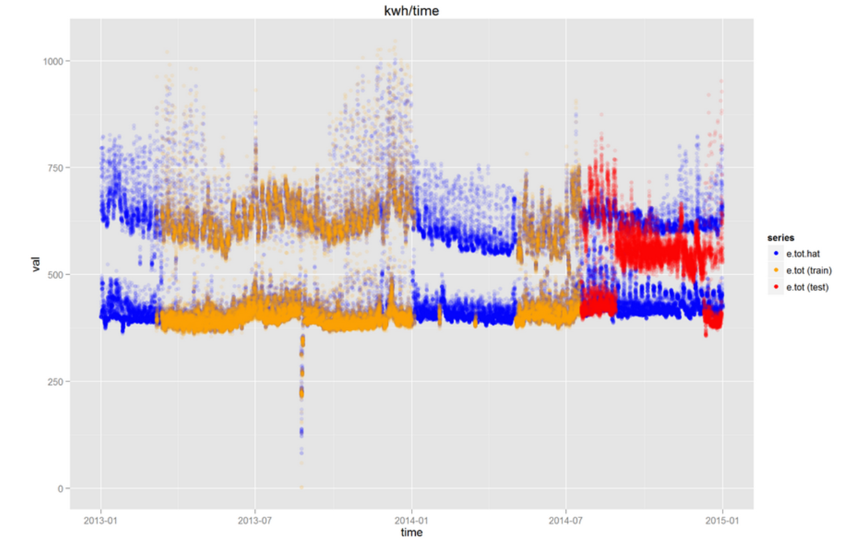
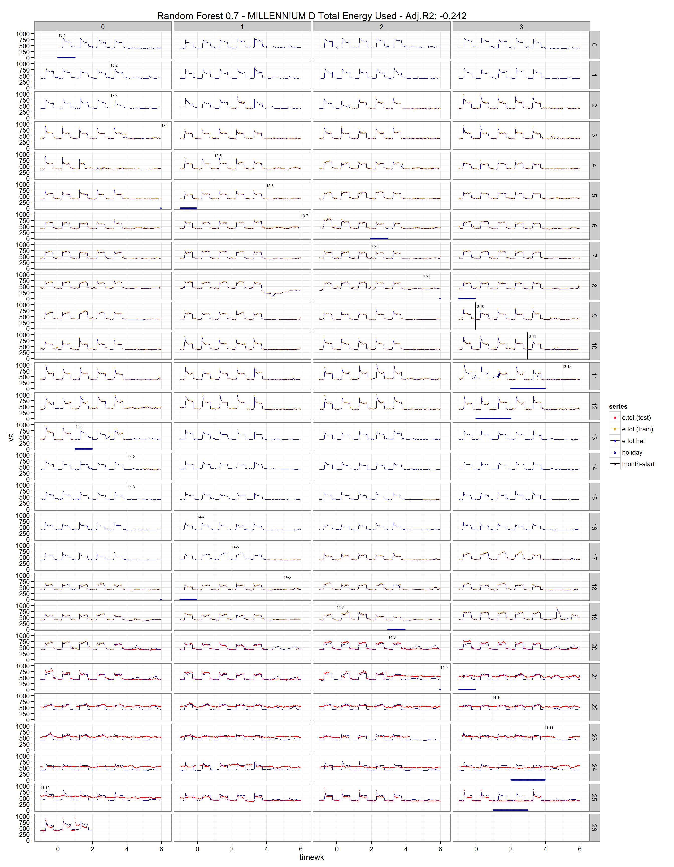
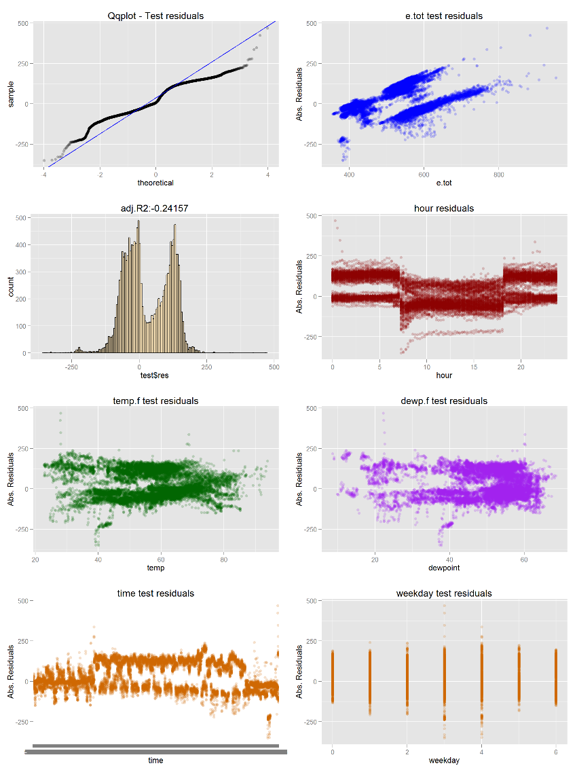
SDB – Modeling – Results (Millenium D)

Slide 34
SDB - Modeling - Key Assets
Building Temp/Energy Reports
Directories
4-Predict
Data
Scripts
modeling

Slide 35
SDB Evaluation - Overview
Evaluated results by setting up web service, running a simulation, and retrieved values
AML Boosted Tree performed best of methods tried, but this is ongoing

Slide 36
SDB Evaluation - Architecture

Slide 37
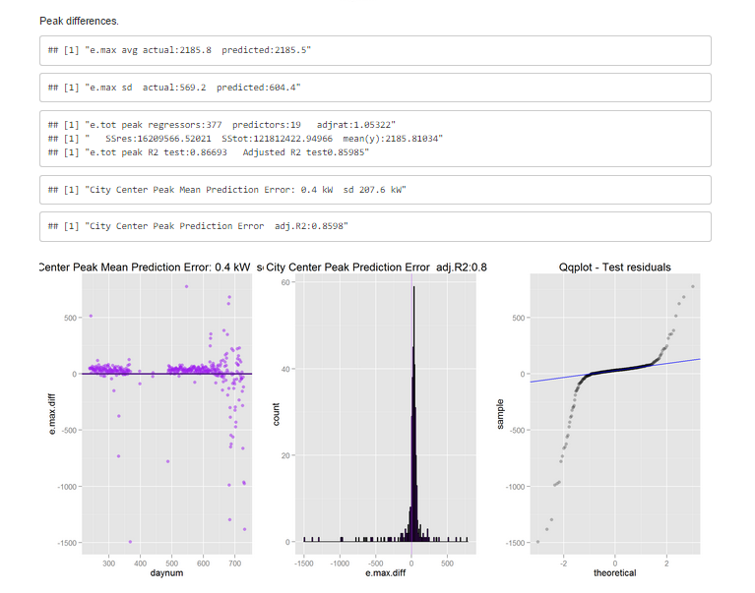
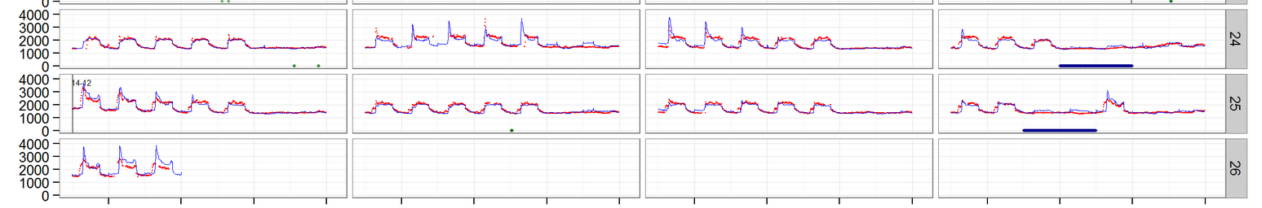
SDB – Evaluation- Results

Slide 38
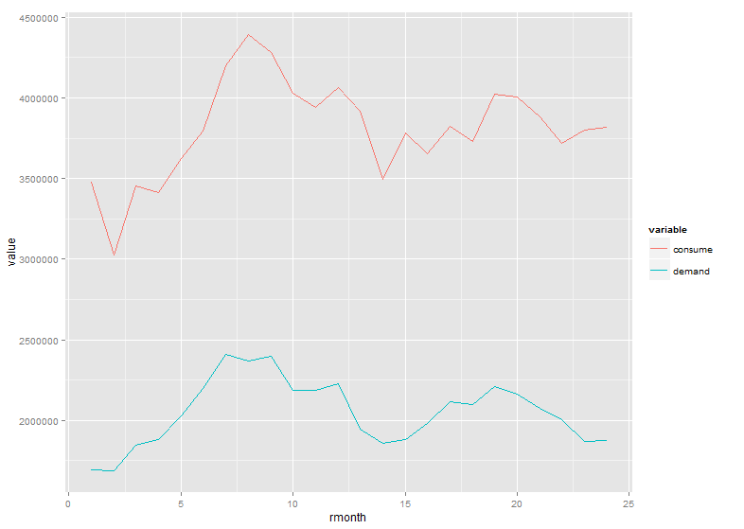
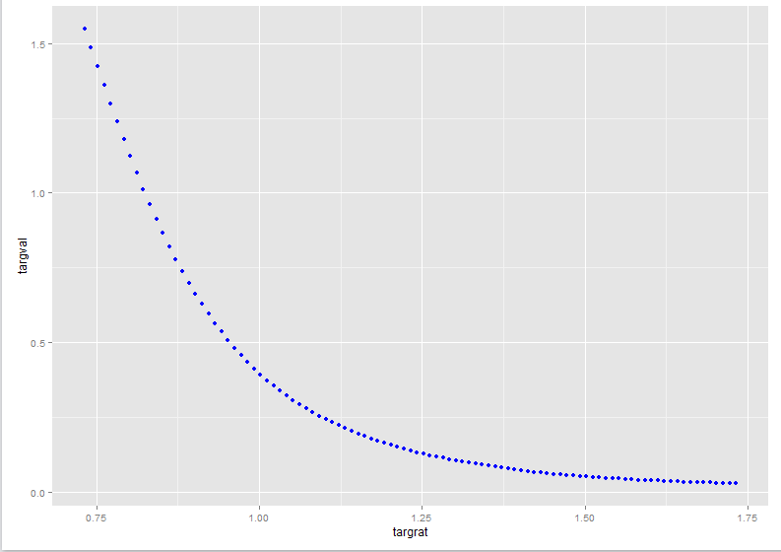
SDB – Evaluation- Results

Slide 39
SDB - Evaluation - Key Assets
Building Temp/Energy Reports
Directories
5-verifyaml
Data
Scripts

Slide 40
SDB Deployment - Overview
Weather Forecasts must be integrated
Needs rational reproducible architecture
Pilot needed to show if returns can actually be realized

Slide 41
SDB Deployment - Architecture

Slide 42
Next Steps
More AML verifications
Caret models
Run Global Model
Wider deadband data
Retrieve OCC values
Consolidate
Merge into deadband

